Slide 1

Deep Learning Course
Khanh Pham Dinh
Hà Nội, 27/12/2021,

Slide 2
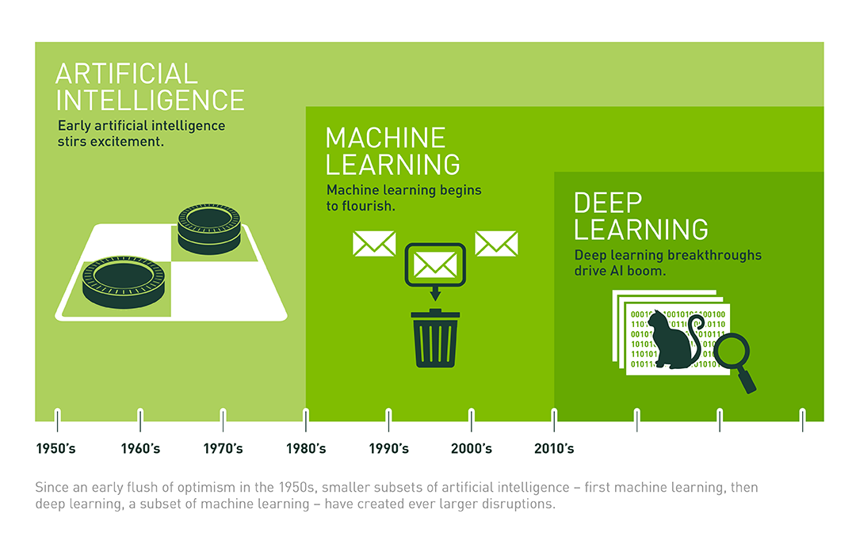
AI domain?
Context of Deep Learning:
Big data
Computational ability
Algorithms
Deep Learning Applications
Neural network

Slide 3
What is Neural Network ?
Forecast house price:
Input x: The size.
Output y: Price of house
price
size

Slide 4
What is Neural Network ?
Forecast house price:
Input x: The size.
Output y: Price of house
price
ReLU
function
size
price
size
Simple neural network with 1 unit

Slide 5
What is Neural Network ?
Forecast house price:
Input:
x1: size of house
x2: number of bed room
x3: distance to the center
x4: province
Output y: Price of house
# bed room
facility
of house
size of house
development
level
price
province
distance
to center
walkability

Slide 6
What is Neural Network ?
Forecast house price:
Input:
x1: size of house
x2: number of bed room
x3: distance to the center
x4: province
Output y: Price of house
# bed room: x1
size of house: x2
province: x3
distance
to center: x4

Slide 7
Supervised Learning Application
Input x
Output y
Application
Size of house | Price | House price prediction
Ad description, User Information | Click (0 no, 1 yes) | Advertisement click
Image | Label (1000 different classes) | Image classification
Image | Bounding box and label | Image object detection
Viet Nam language | English Language | Machine Learning Translation
Audio Signal | Text transcript | Speech recognition

Slide 8
Supervised Learning Application
Input x
Output y
Application
Size of house | Price | House price prediction
Ad description, User Information | Click (0 yes, 1 no) | Advertisement click
Image | Label (1000 different classes) | Image classification
Image | Bounding box and label | Image object detection
Viet Nam language | English Language | Machine Learning Translation
Audio Signal | Text transcript | Speech recognition
Neural
Network
CNN
RNN,
Transformer

Slide 9
Why Deep Learning Era ?
Model
performance
Big NN
Medium NN
Small NN
Machine Learning
Dataset size
small data

Slide 10
What accelerate Deep Learning ?
Data
Computation
Algorithm
Data is everywhere
IoT
Application/web
Many big labeled data
2009 ImageNet, Fei fei lee.
afterward, more Benchmark dataset for research.
GPU
Deep Learning framework: tensorflow, pytorch, mxnet, caffe,...
Activation Function
Batch Normalization
Loss function
Optimizer
CNN
Mobilenet, SqueezeNet,...
VGG, ResNet, ResNext,...
RNN: LSTM, GRU, BiLSTM, BiGRU,...
Transformer: BERT, GPT, BART, T5,...

Slide 11
About this course
Who can study?
High school Student
Bachelor
People who want to study and use AI in work
What is the input requirement?
Not much.
Basic python programming like.
Understanding python structure: list, dict, tuple, set
Class, function and module in python.
nice to have: git, command line
Math: Basic knowledge about matrix like +, - , x, /.
What is output of this course?
Have general idea about deep learning.
Know how to train a deep learning model.
Re-implement a paper.
Deploy model.

Slide 12
About this course
Programming & math
1.1. List, dict, tuple, set
1.2. for, while, try catch
1.3. function/class
1.4. module
1.5. git and command line
1.6. Overview Math: matrix, vector, scalar operation
Tensorflow
2.1. scalar, vector, tensor
2.2. layers in tensorflow
2.3. Initial first neural network in tensorflow
Pytorch
3.1. scalar, vector, tensor
3.2. layers in pytorch
3.3. Initial first neural network in pytorch.
Neural network and Deep Learning
4.1. Introduction Neural Network
4.2. Basic of Deep Learning Network:
Feed Forward, Back propagation
4.3. Optimizer
4.4. Loss function
4.5. Single Layer neural network
4.6. Multi Layers neural network
5. Foundation of CNN
5.1. Strided Convolution
5.2. MaxPooling
5.3. Simple CNN network
5.4. Common CNN architectures
6. Transfer Learning & Data Augmentation
6.1. What is transfer learning
6.2. Warm up
6.3. Fine tuning
6.4. Data Augmentation
6.5. Knowledge distillation
6.6. Curriculum learning
7. Two Stage Object Detection & Image Segmentation
7.1. R - CNN
7.2. Fast - RCNN
7.3. Faster - RCNN
7.4. U-Net
8. Single stage object detection
8.1. Anchor base
8.2. Bbox prediction
8.3. NMS
8.4. YOLO algorithm
8.5. SSD
8.6. Rentina Net
9. Face Recognition
9.1. What is face recognition
9.2. One shot learning
9.3. Siamese network
9.4. Triplet loss
9.5. Implement Face verification
10. Recurrent Neural Network
10.1. RNN architecture
11.2. LSTM, GRU
12.3. RNN application
11. Transformer
11.1. Attention mechanism
11.2. Transformer architecture
11.3. General NLP problems.
11.4. Machine Learning translation practice.
12. GAN
12.1. Introduction GAN
12.2. Common GAN algorithms
12.3. Implement GAN in style transfer.
13. Deploy model with Tensorflow Lite
13.1. Convert model into Tensorflow Lite
13.2. Quantization model.
13.3. Deploy model on Android app
14. Final project

Slide 13
About this course
Specification:
Free compute resource: colab and kaggle.
Language: python, java.
Framework: pytorch, pytorch-lite, tensorflow, keras.
Assignment:
Homework Assignment: 5-10 questions each session.
One kaggle contest.
One final project.
Certification:
Complete >= 80% homework assignment
Join kaggle contest
Done final project

